Slide 1
Cooking with AWS and Splunk
Overview Module
Kam Amir | Splunk Cloud Architect

Slide 2
Cooking Class Overview
Pre-Work
Workshop
Getting Started with AWS
AWS Account
APN Account
Configure AWS
IAM Policy / Roles
AWS Config
Setup Infrastructure / Splunk
Deploy AWS Marketplace AMI
Setup Splunk App for AWS
AWS Cloudtrail
AWS CloudWatch
Troubleshoot App
Modular Inputs
VPCFlow Logs
Search _internal
Validate Permissions
Check Inputs
AWS Services Explained
AWS Config
AWS CloudTrail
Lambda / HEC
AWS CloudWatch
Saved Searches, Macros, DMA
Migrating AWS TA between machines
Move Accounts, inputs from SH to HWF
Trumpet / Kinesis Data Firehose

Slide 3

Purpose
AWS Field Enablement
Splunk App for AWS Enablement
Troubleshooting Splunk and App for AWS
Intended for Technical Field Members (Partners, Support, SE’s, SME’s, CSM etc.)
Formal Process for Supporting Splunk in AWS and the associated Splunk App for AWS
Notes:
The purpose for this course is to help the field understand the components found in AWS and how they are relevant to Splunk and the customer. This course assumes you have some basic Splunk knowledge and how to install the product along with basic Linux / sysadmin skills. The accompanying modules will walk you through the entire lifecycle of creating an AWS account to having a working Splunk instance with the App fully functioning.

Slide 4
Signing up for Amazon Partner Network (APN)

Slide 5
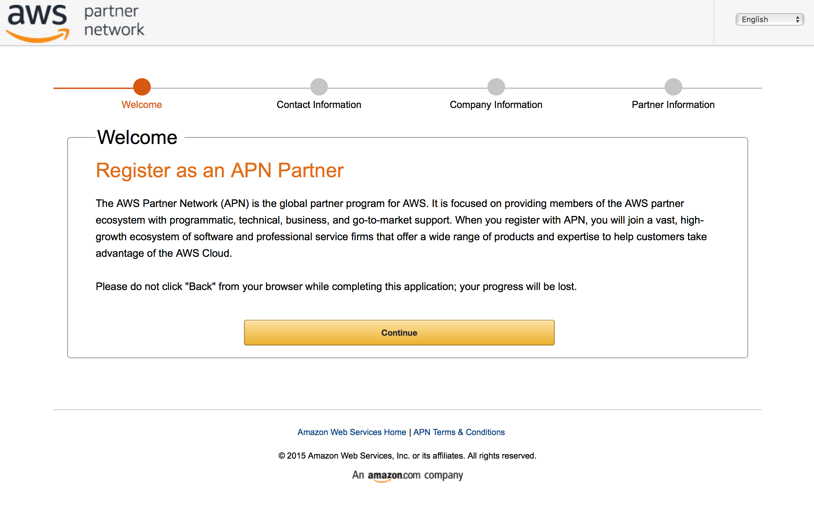
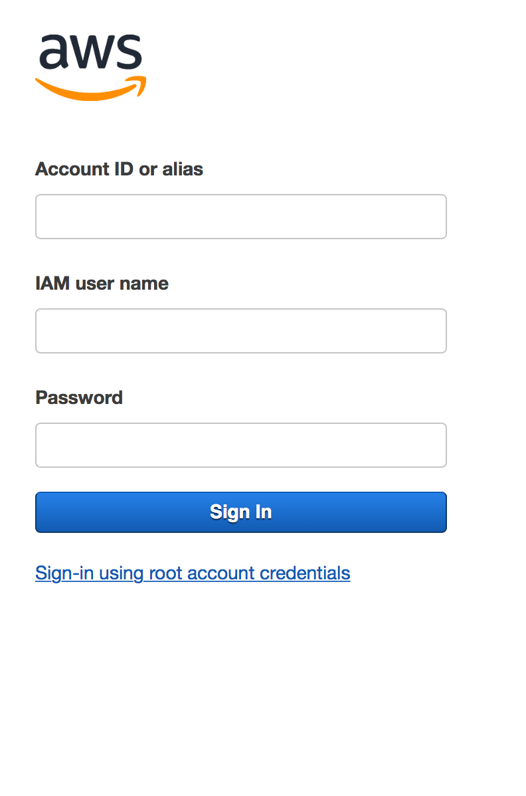
Sign up for the Partner Portal
Go to https://aws.amazon.com/partners
Required for Partner Portal
A valid work email account
An AWS
Account
Notes:
For additional resources, please join the Amazon Partner Network. This free service will give you access to online learning and discounts to in-person classes.

Slide 6
Continue to Module 1: Getting Started with AWS

